Slide 1
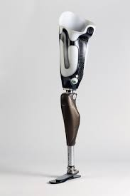
Bionic Leg

Slide 2
Introduction of Bionic Leg
Project Objective:
Improve the quality of life for amputees.
Combine IoT technology and prosthetics to create a bionic leg that can adapt to the user's needs.
Benefits:
Enhanced mobility.
Improved quality of life.
Data-driven insights for personalized care.

Slide 3
Key Features of Bionic Leg
IoT Integration:
Real-time data collection and analysis for optimal performance.
Adaptive Design:
Adjusts to user movements and terrains.
Enhanced Comfort:
Designed for prolonged use and comfort.
Remote Monitoring:
Allows healthcare professionals to monitor patient progress.

Slide 4
Project List
Smart Switch
Smart Chair
Fingerprint Door Lock
Bionic Hand /Leg
Network Jammer
Smart Fish Feeder
Network Jammer
Automatic Garage Door Open

Slide 5
Problem Statement
Servo Motor Calibration
EMG Kit Installing
Final Design
Initial Position of Servos
Bionic Leg Connecting with IOT Cloud
Final Circuit

Slide 6
Components
Arduino Uno ( 1 )
Servo (MG996R) ( 2 )
PWM Driver (PCA9685) ( 1 )
EMG Kit (AD8232) ( 1 )
Piezoelectric Sensor ( 4 )
12v Rechargeable Battery ( 1 )

Slide 7
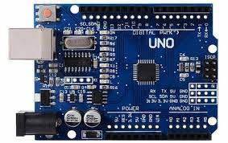
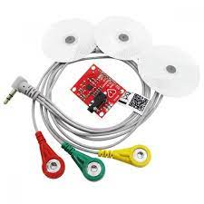
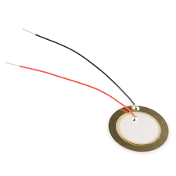
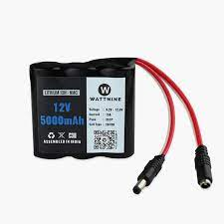
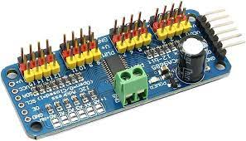
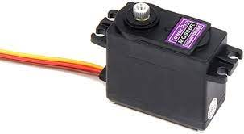
Components

Slide 8
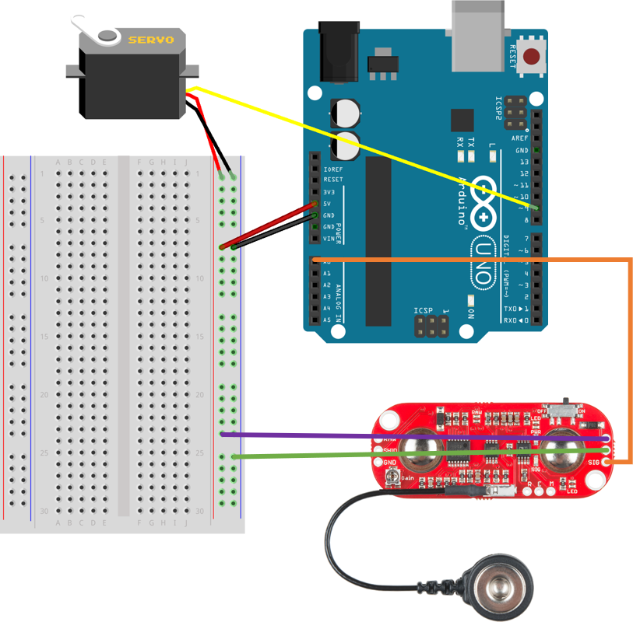
Circuit Diagram

Slide 9
Design
We want to make this project with waste material.
So, It is very difficult and complex.

Slide 10
Conclusion
Our IOT Bionic Leg project is a groundbreaking effort to improve the lives of amputees by enhancing mobility. We invite you to join us on this transformative journey, as your support can make a real difference.

Slide 11


